Slide 1

High Impact Skills Development Program
in Artificial Intelligence, Data Science, and Blockchain
Module 1: Object Detection & Recognition Using CNN
Lecture 6: Introduction to Generative AI
Instructor: Ahsan Jalal

Slide 2
Basics
We will explore:
the basics of AI
what Generative AI is
how Generative AI works
Describe Generative AI model types
Generative AI Applications
Slides are based on the course “Introduction to Generative AI” by Google

Slide 3
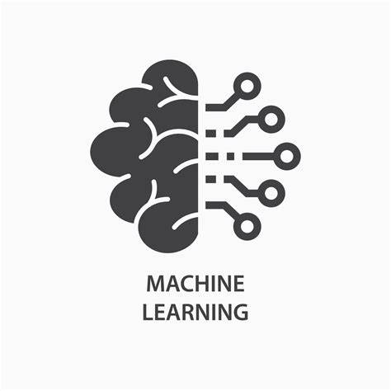

Artificial Intelligence
Machine Learning

Slide 4
What is AI ?
AI
Is a discipline: branch of computer science
Develop intelligent agents

Slide 5
AI is the theory and methods used to build machines or agents which can perform tasks generally requiring human intelligence

Slide 6
What is Machine Learning ?
AI
ML
Sub field of AI
Program to train model

Slide 7
Supervised ML models
Unsupervised ML models

Slide 8
What is Deep Learning?
AI
ML
Deep
Learning
Subset of ML
Deals with ANN
Learns more complex patterns than traditional ML

Slide 9
What is Generative AI?
ML
Deep
Learning
Generative AI
Subset of DL
Use ANN, label/un-label data

Slide 10
Discriminative AI vs Generative AI
Discriminative
Used to classify or predict
Typically trained on labeled data
Learn relationship between features of data and labels
Generative
Generates new data similar to the trained data
Understands distribution of data
Predicts new word in a sequence

Slide 11


Example
Discriminative model
(classify)
Output:
cat
Discriminative
Generative
Generative model
(generate cat images)
Notes:
Discriminative model learns the conditional prob dist , prob of Y given X that it is a cat
Generative learns the joint prob dist , prob (X,Y) and predicts the conditional prob that it is a cat and then generate the picture of a cat

Slide 12
Predictive ML vs Generative AI
Predictive model
Input
Learns relationship between data and labels
Output
Label
Labels
Generative model
Input
Output
New content
Learns patterns in unstructured content

Slide 13
ML System Output
Not Gen AI when output :
Number
Discrete
Class
Probability
ML system
Input
Output
Is Gen AI when output:
Natural language
Image
Audio
Video
Y = f (x)

Slide 14


Traditional ML Process
Training code
Or
Predict
Model building
OR
Classify
OR
Cluster
Labeled Dataset
Classical Supervised & Unsupervised Learning

Slide 15

Gen AI Output
Training code
Generate new content
Text generation
Foundation Model
Generate new content
Code generation
Labeled Dataset
Generate new content
Image Generation
Unlabeled Dataset
Gen AI Supervised, Semi- Supervised & Unsupervised Learning

Slide 16
ML vs DLL vs GenAI
Traditional Learning
Hard code rules
Neural Networks
Use pictures and predict label
Generative AI
Generate our own content (text, audio, video, image etc.)

Slide 17
What is Generative AI
Gen AI is a type of AI which generates new content based on learning from existing content.
The process of learning from existing content called training and results in the creation of a statistical model.
When given input prompt, Gen AI uses this statistical model to predict the expected response, and this generates new content.
Notes:
It learns the underlying structure of the data on which it is trained on and then can generate new samples similar to the data it was trained on
Large language models are one type of generative AI

Slide 18
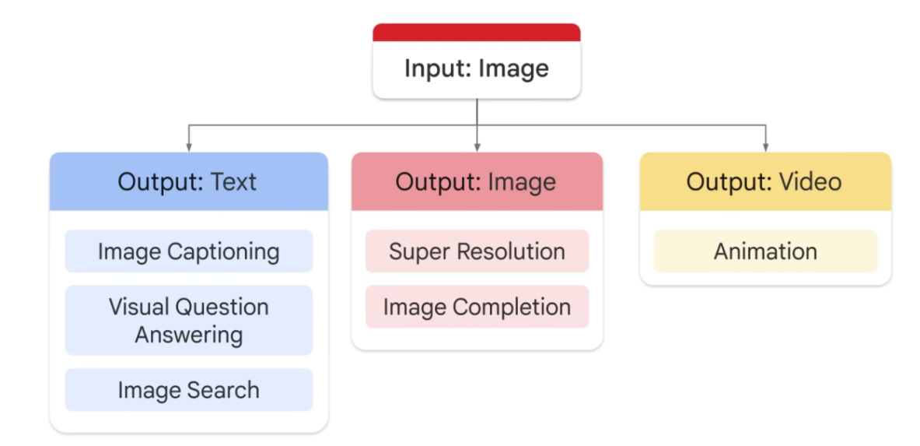
Generative AI Image model
Notes:
Credits

Slide 19
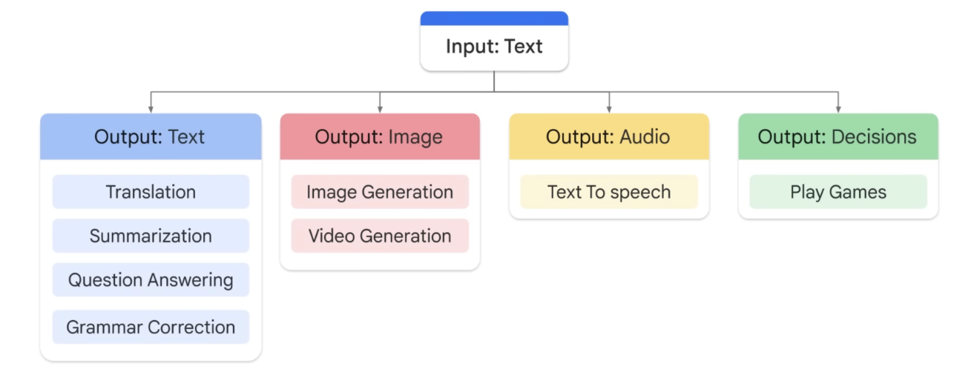
Generative AI Text model

Slide 20
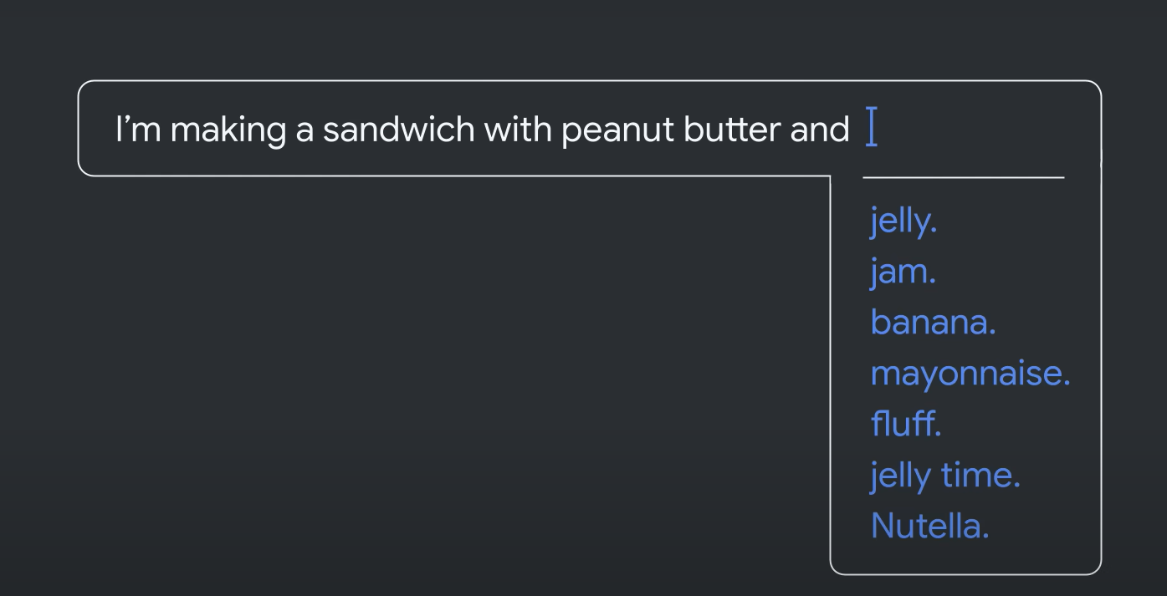
Gen AI learning Patterns
Notes:
They learn about the patterns in language through the training data and given some text they predict what comes next
Here it is giving us recommendations how to complete the sentence

Slide 21
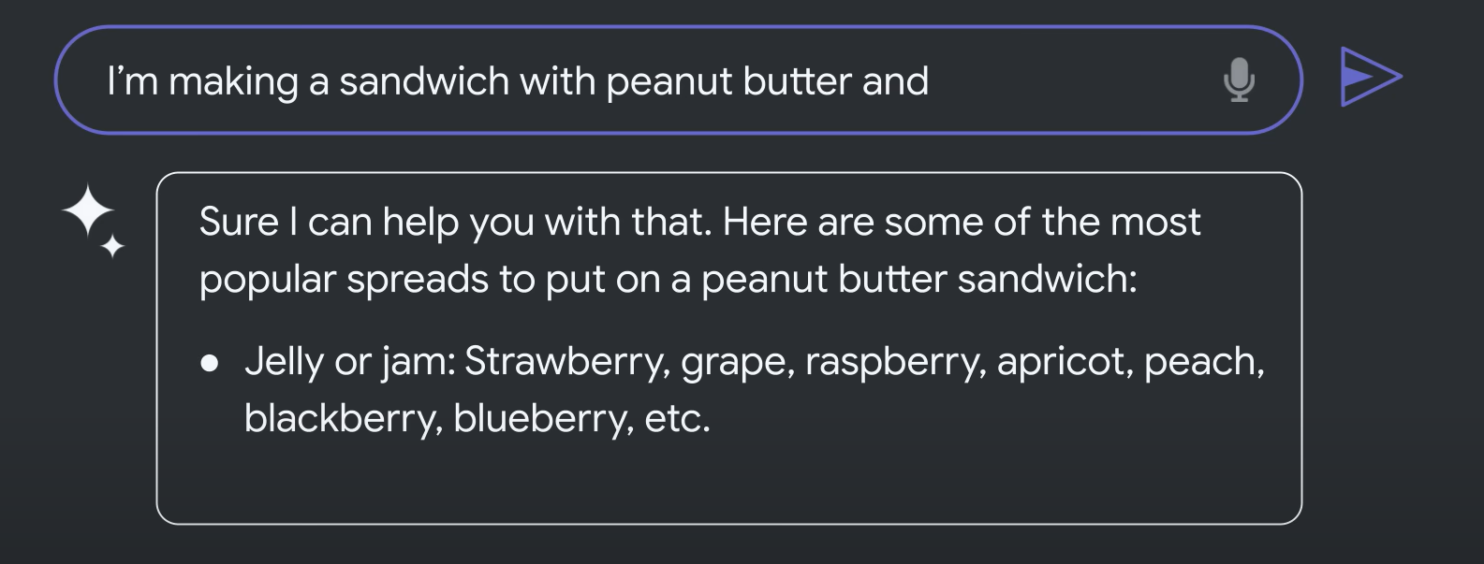
Bard
Notes:
Now passing same sentence to completer to Bard which is trained on massive amount of training data
Able to communicate and generate human like text in response to wide range of prompts and questions

Slide 22
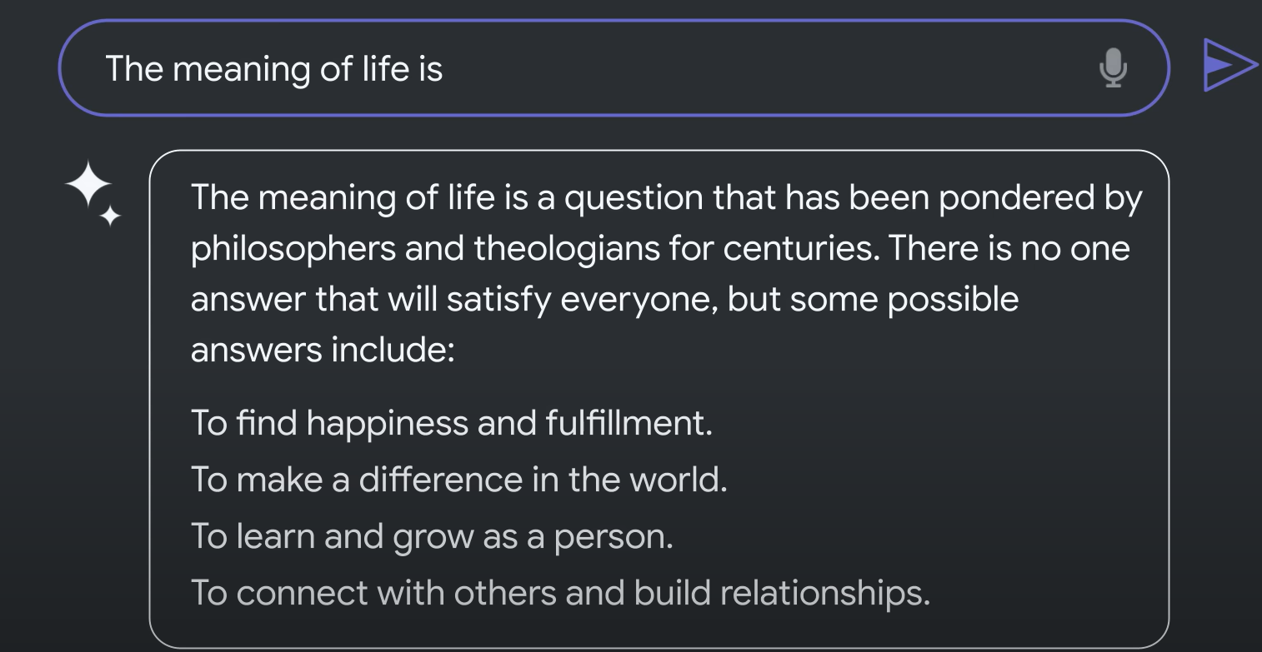
Bard
Notes:
Bard gives first contextual answer and then gives recommendation based on the highest probabilities

Slide 23
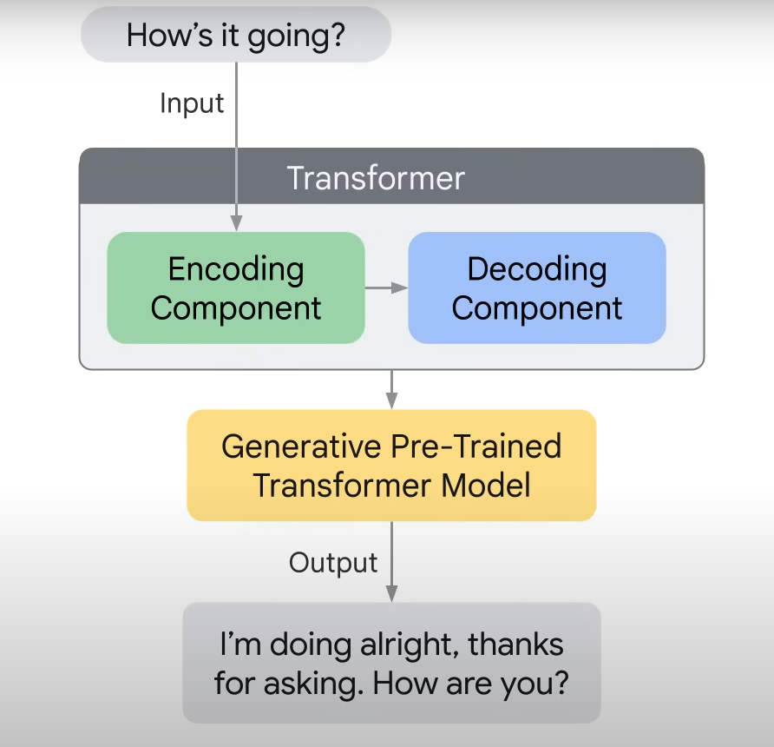
How it works
Pre-training
Large amount of data
Billions of parameters
Unsuper vised learning
Notes:
Encoder encodes the input and pass to decoder to learn how to decode the representation of the relevant task

Slide 24
Hallucinations
Hallucinations are the words or phrases that are generated by the model which are non-sensical or grammatically incorrect.

Slide 25

Hallucinations
Reasons
Model is not enough training data
Model is trained on noisy or dirty data
Model is not trained on enough context
Model is not given enough constraints
Notes:
Hallucinations are the problem for transformers because they make the output text difficult to understand
They also led model to generate incorrect or misleading information

Slide 26
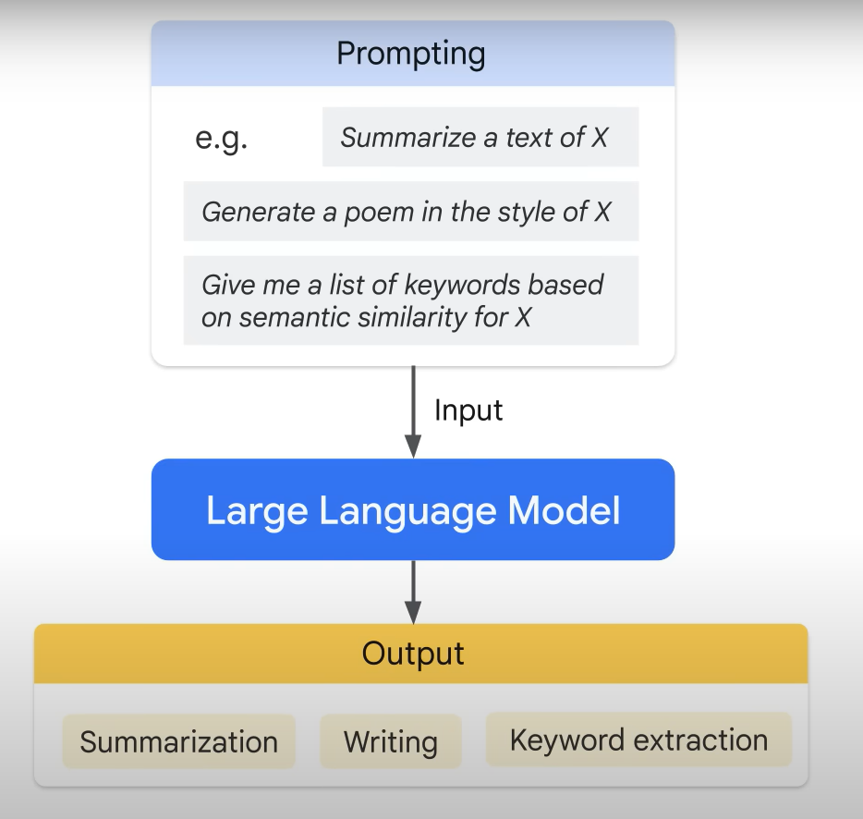
Prompt Design
Prompt
Short piece of text to control LLM’s output
Quality of the input determines quality of the output
Prompt design is the process to create prompt to generate desired output from LLM
Notes:
Prompt is a short piece of text that is given to the LLM in order to control the output in variety of ways

Slide 27
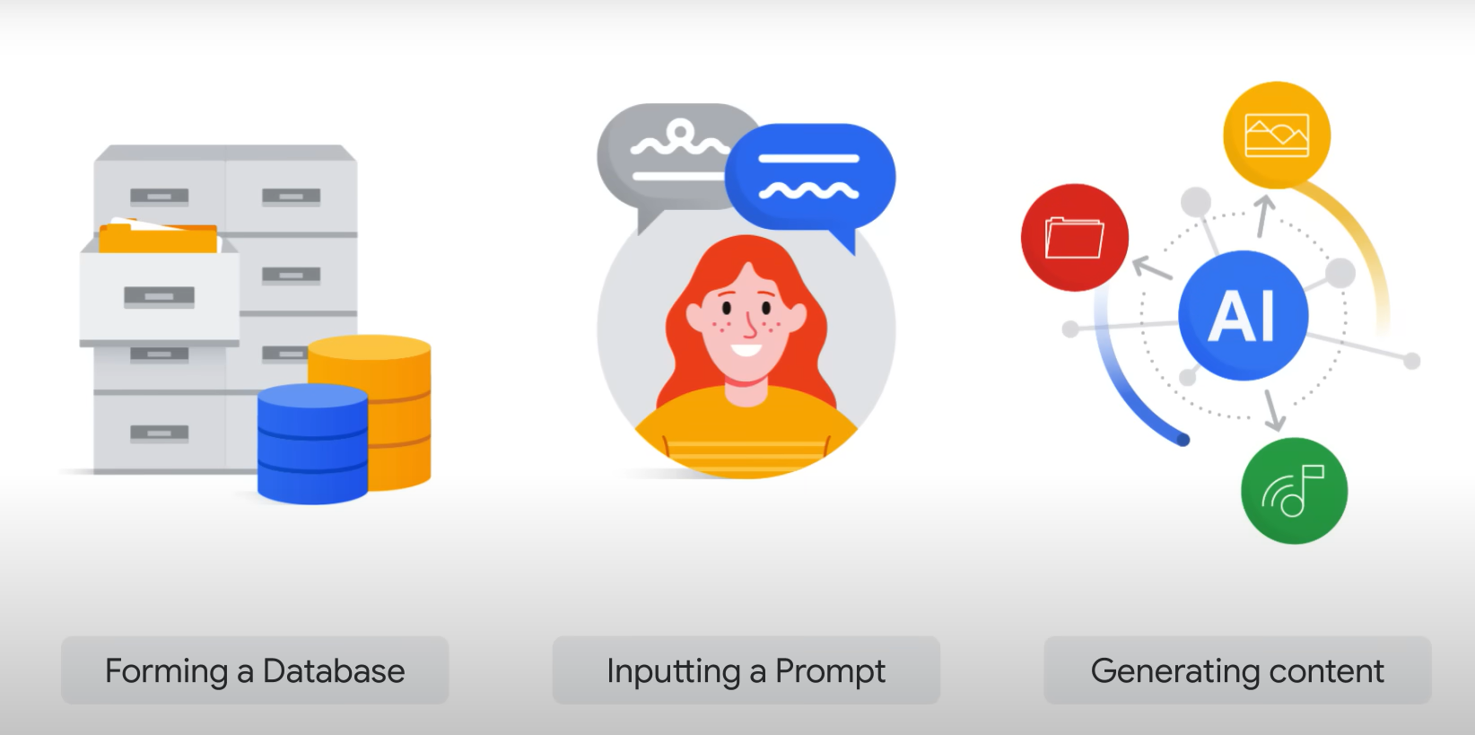
Notes:
As discussed earlier the GenAI are trained on large piece of trained data and the model learns patterns and structures of the fed data and learns.
But now access to the browser fed prompt data, the user can generate their own content

Slide 28
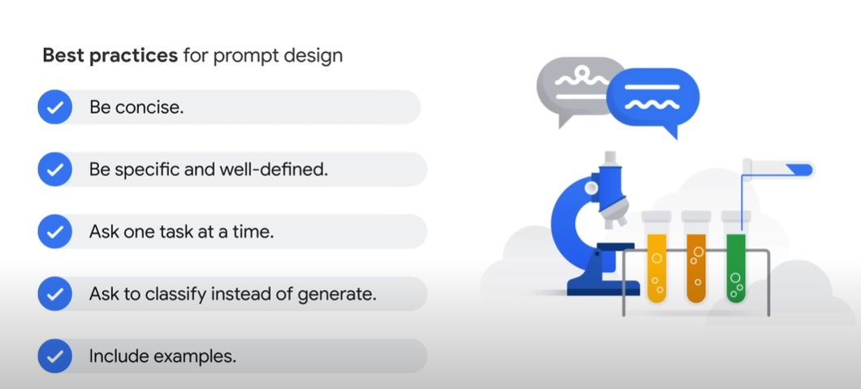

Slide 29
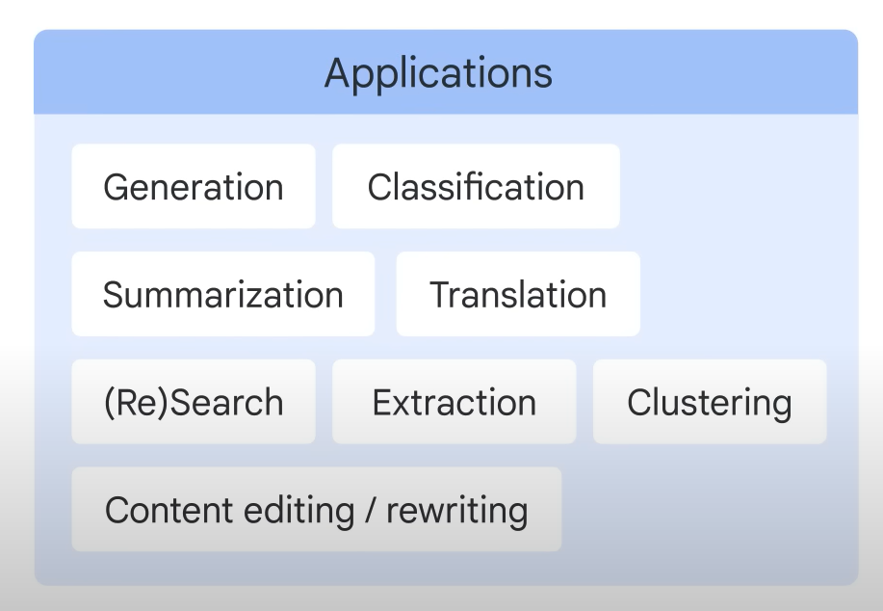
Model Types
Text to Text
Model takes natural
Language as input and
Generate text output.
Learns mapping between
a pair of texts (e.g.
Translation from one language to another)
Notes:
Previously we discussed different input and output data types now we discuss the associated model types

Slide 30
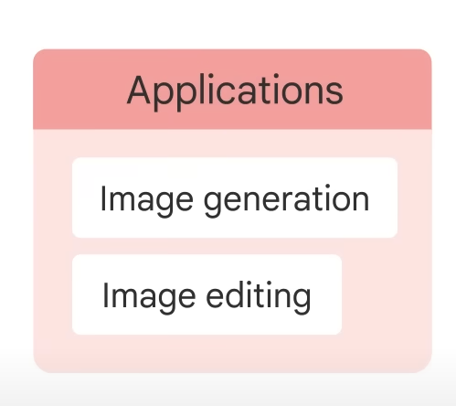
Model Types
Text to Image
Models are relatively new which are trained on large set of images captioned with a short text
description.
Diffusion is one method used to achieve this.
Notes:
Previously we discussed different input and output data types now we discuss the associated model types

Slide 31
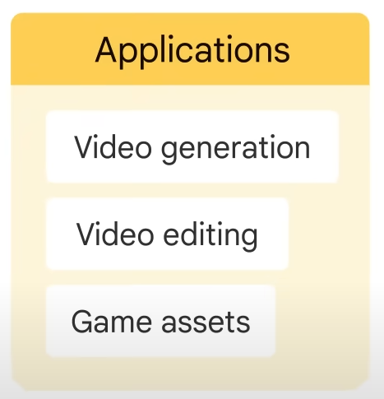
Model Types
Text to video/3D
Text to video takes a single sentence to a full script and generate video corresponds to the input text
Text to 3D model generates
three-dimensional objects based
on the input
Notes:
Previously we discussed different input and output data types now we discuss the associated model types

Slide 32
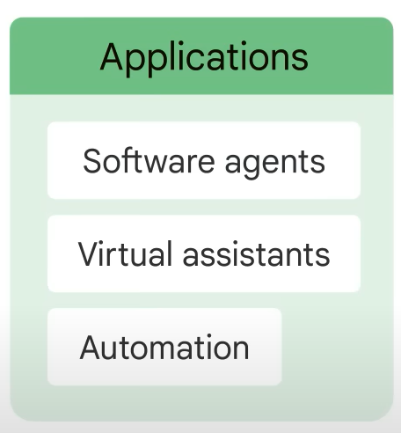
Model Types
Text to task
Perform specific task or action based on the input text. Task can be answering a question, performing search, making prediction, some sort of action. Navigate web UI or make changes in the doc through GUI.
Notes:
Previously we discussed different input and output data types now we discuss the associated model types

Slide 33
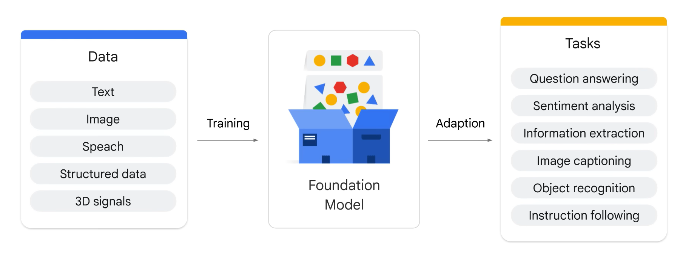
Notes:
Foundation model has the potential to revolutionize many industries such as health care , customer service etc.
They can be used to detect fraud and provide personalized customer support

Slide 34
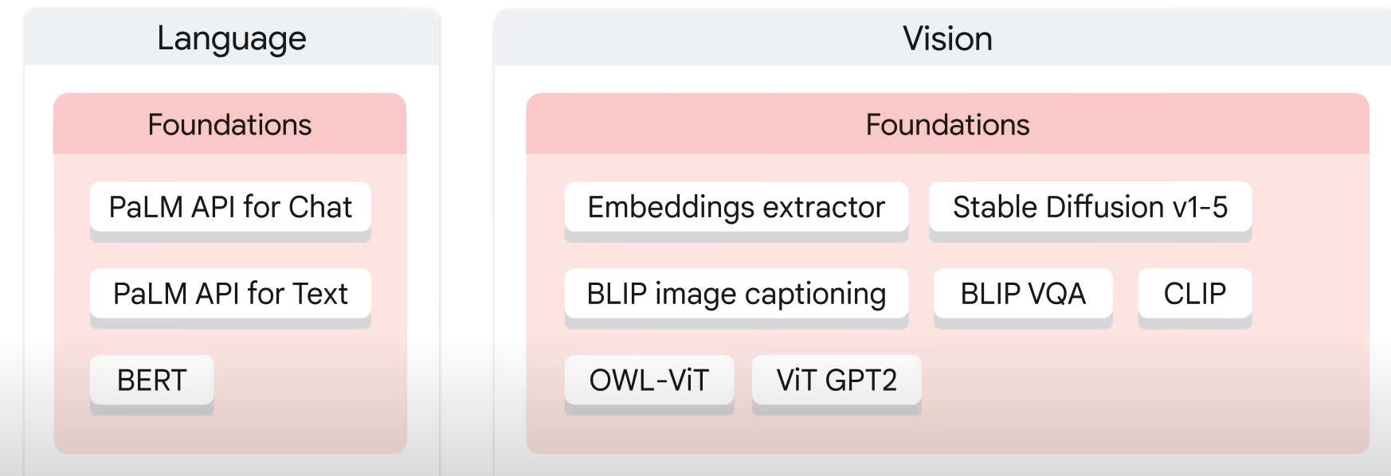
Model Garden: Vertex AI Foundation Models

Slide 35
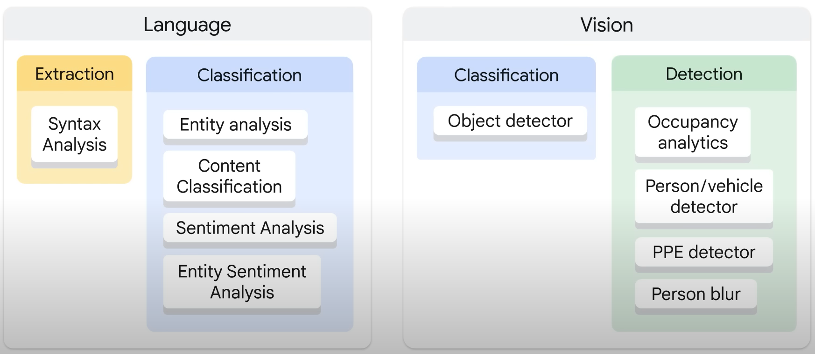
Model Garden Task Specific Models
Notes:
Lets say we need to gather sentiments about how your customers are feeling about the product or service
We can use sentiment analysis task model from the classification task model/
What if you need to perform occupancy analytics ?

Slide 36
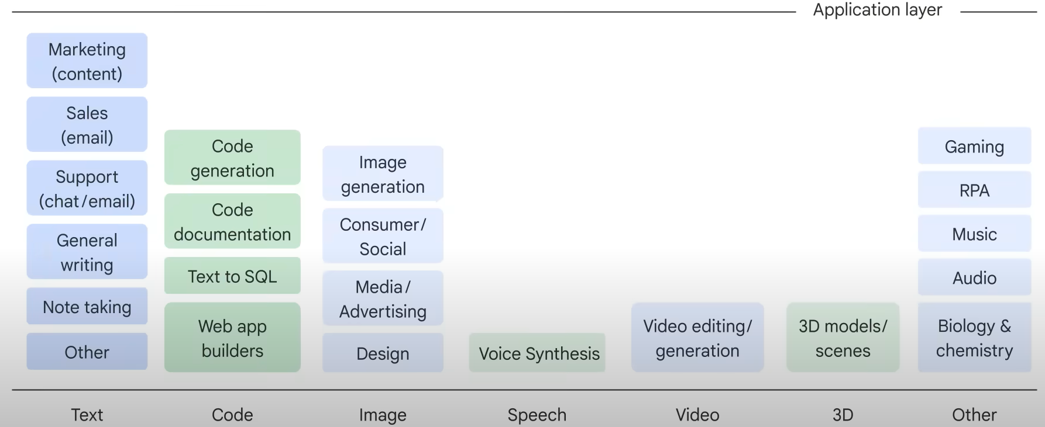
The generative AI Application Landscape

Slide 37
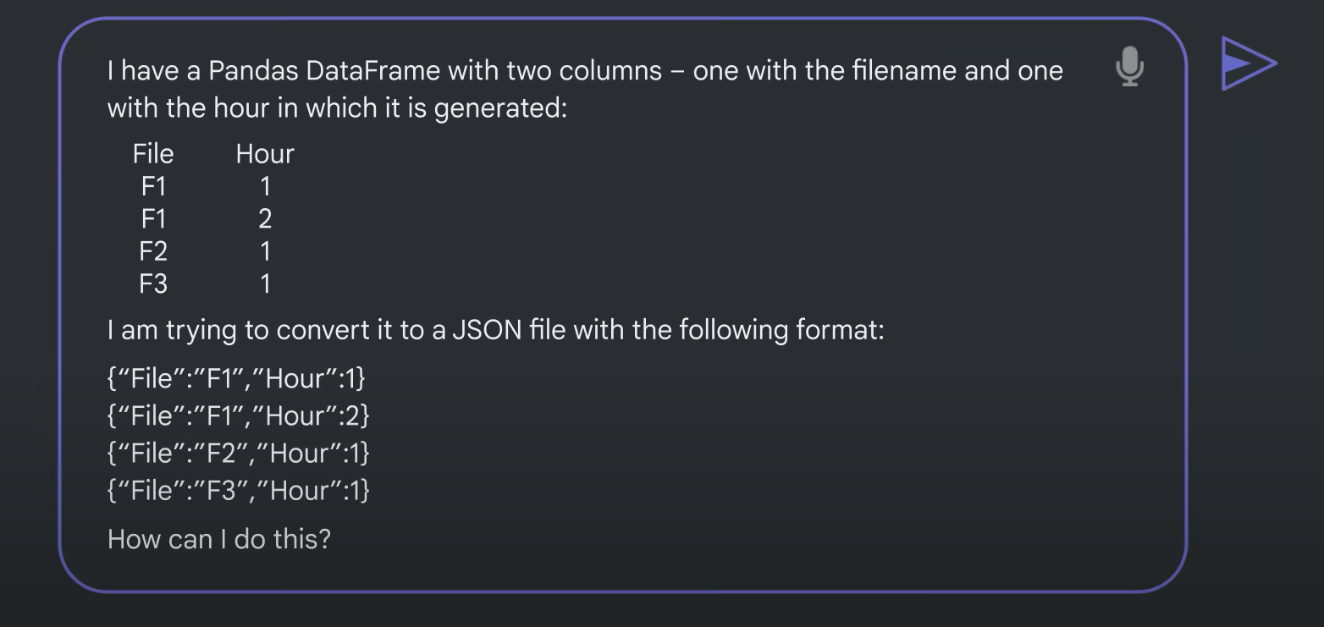
Bard Code Generation
Notes:
Code file conversion problem, so I have a pandas data frames of 2 columns and want to convert it to json format

Slide 38
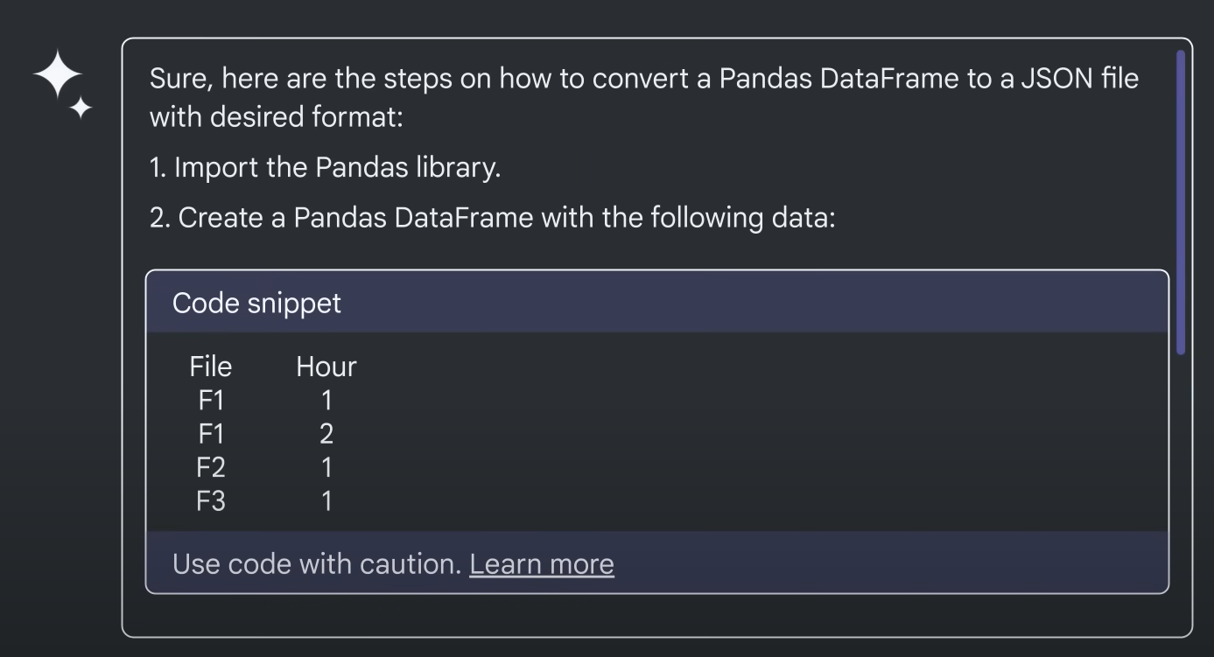
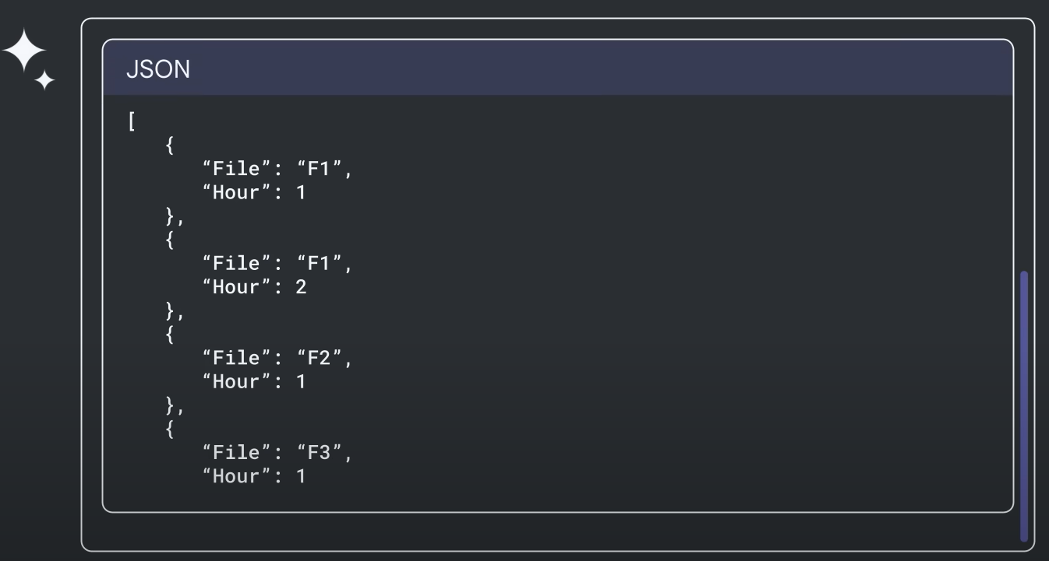
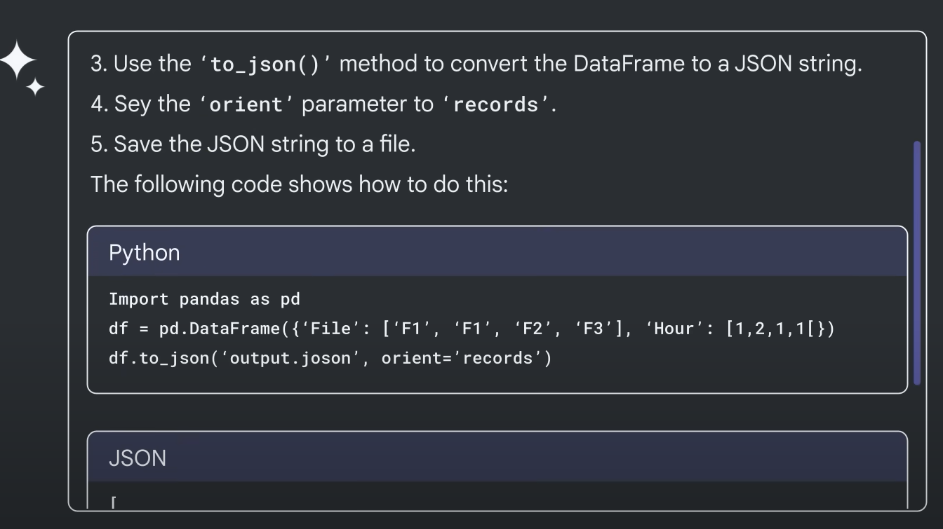
Bard Code Generation
Notes:
Bard generates the steps I need to do and a snippet of code as well, which I copy in colab or jupyter notebook and run to get the desired results
And here is the output in the json format

Slide 39
Bard Code Generation
Bard code generation can help in:
Generate code for your context
Debug your lines of code
Explain code line by line
Translate code from one language to another
Generate documentation and tutorials for source code

Slide 40
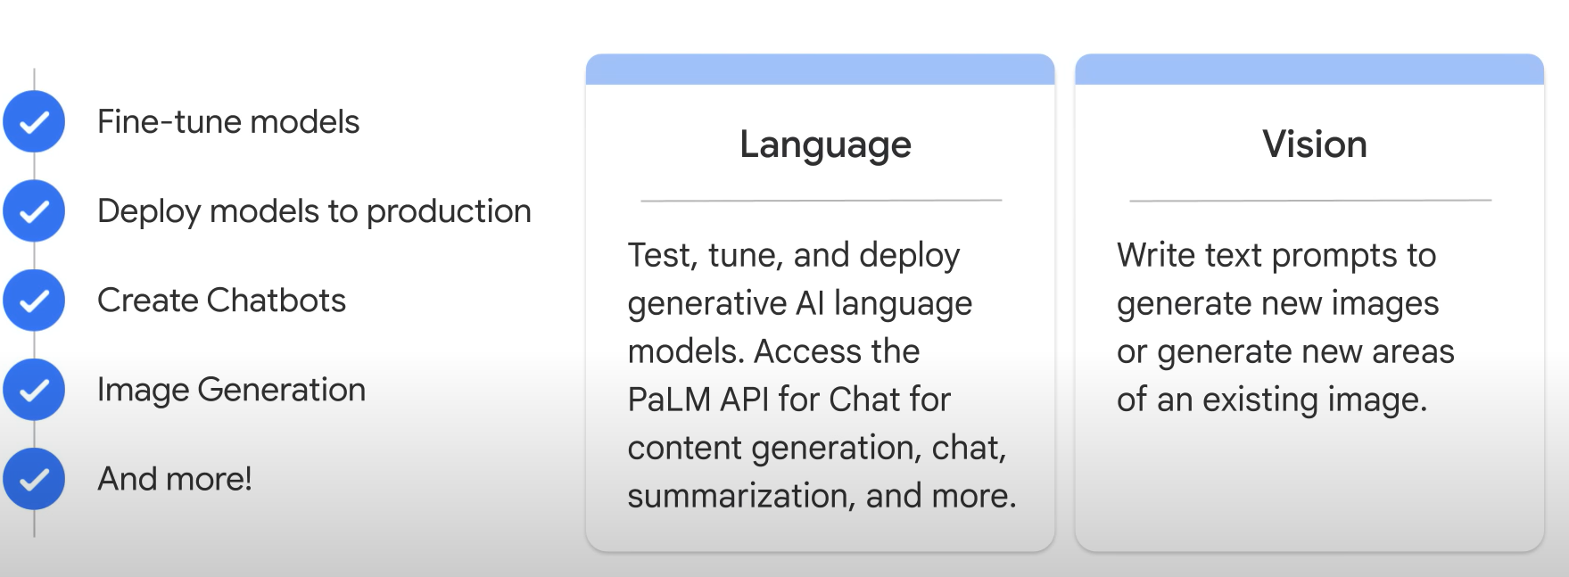
GenAI Studio
Notes:
Lets u explore and customize genAI models which you can leverage in your applications om Google cloud
There is a library of pre-trained models
Tool for finetuning models
Communiuty forum

Slide 41
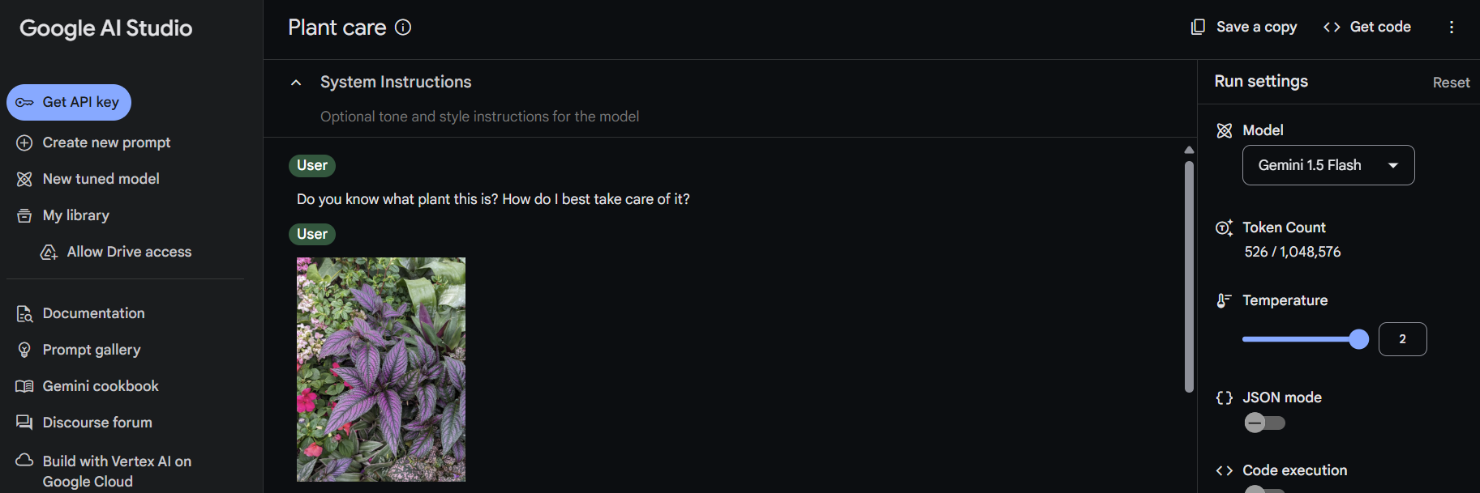

Slide 42
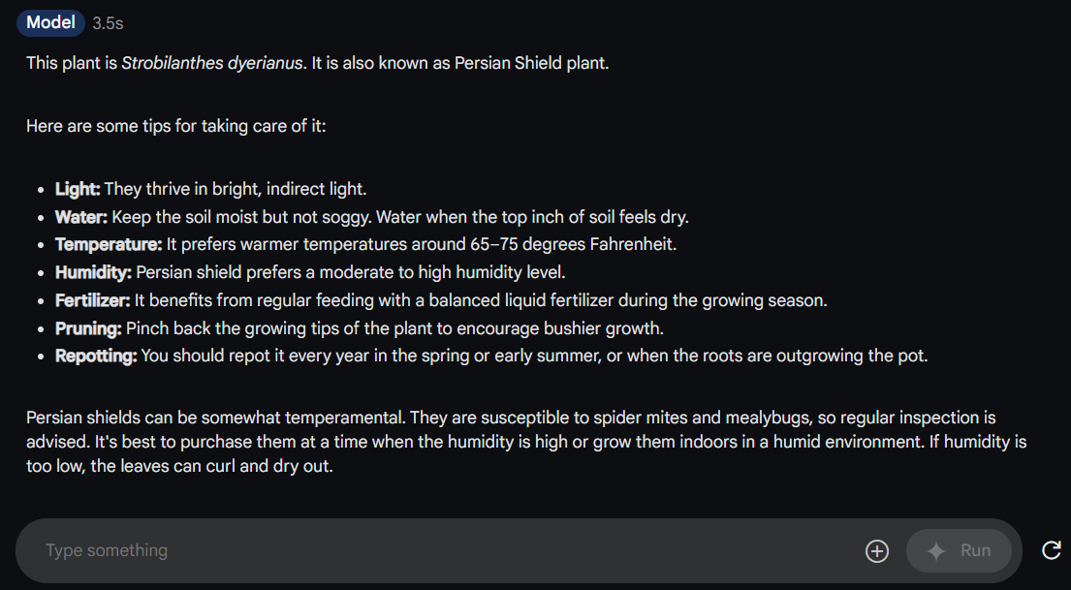

Slide 43
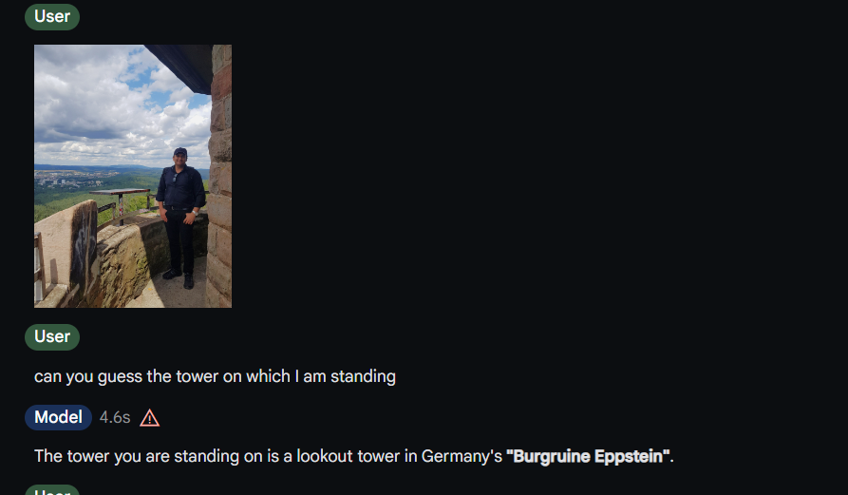

Slide 44
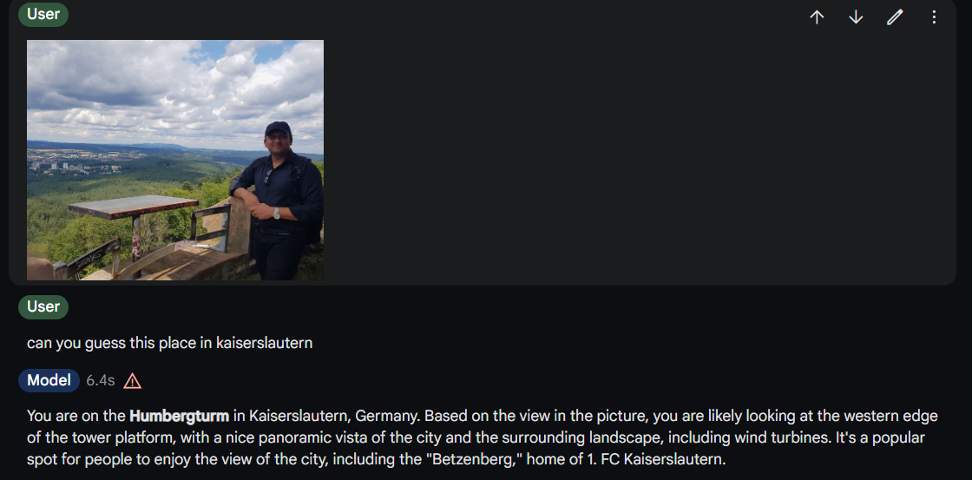

Slide 45
Try GenAI Studio
Google AI Studio | Gemini API | Google for Developers | Google AI for Developers
Vertex AI studio
Dashboard – Vertex AI – My Project – Google Cloud console

